Slide 1

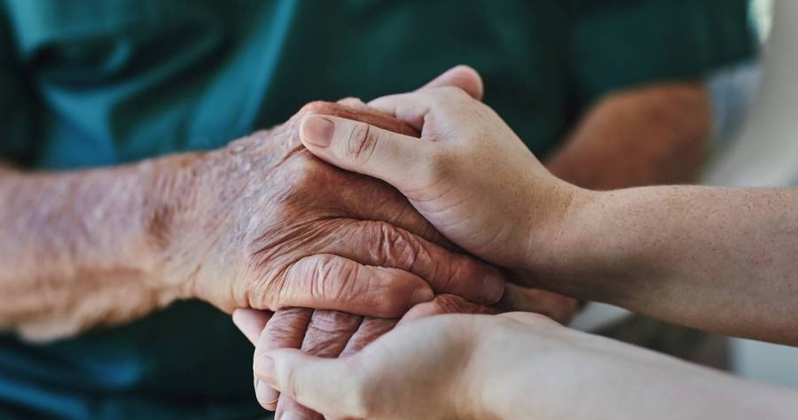
WELCOME
WELCOME

Slide 2
Department of Computer Science and Engineering
Computer Aided Detection of Breast Cancer Using Bio Inspired Algorithm
PRESENTED BY
Peddi Kavya 21471A0544
Bolla Vinay Pooja 21471A0510
Bandi Poojitha 21471A0549
Under the Guidance of,
Syed Rizwana_{, M.Tech., (Ph.D)}
Assistant Professor
Department of Computer Science and Engineering,
Narasaraopeta Engineering College (Autonomous),
Narasaraopet- 522 601.

Slide 3
OUTLINE
Abstract
Introduction
Literature Survey
Research Gaps
Problem Statement
Objectives
Block Diagram / Flow Diagram
Methodology
Implementation
Results and Analysis
Conclusion & Future Scope
References
Question and Answers
Acknowledgements

Slide 4
ABSTRACT
Breast cancer still ranks among the most common causes of cancer-related deaths among women, hence the call for early diagnosis. Mammography is the most accepted screening test, but conventional Computer Aided Detection (CAD) has a high false positive rate (FPR) that gives rise to biopsy and false negatives (FN) where cancer is undetected. In solving these challenges, this paper provides a solution by employing the use of the Simple Genetic Algorithm (SGA), which is openly inspired from biological systems to enhance the performance of CAD systems for breast cancer detection. The SGA, which is based on the evolutionary process, can resolve problems in feature selection and classification of the mammogram by overcoming shortcomings of pattern recognition. By mimicking the genetic evolution process, ant colony optimization, and swarm intelligence, the SGA prevents noisy or variant images to anyhow decrease the detection accuracy. Comprehensive tests on typical sets of mammograms confirm the effectiveness of the proposed approach regarding a two fold reduction of inappropriate positive and negative results

Slide 5
INTRODUCTION
There is a growing demand for early and accurate breast cancer diagnosis, especially in countries like India, where the prevalence of cases is rising. Mammography is the most effective and non-invasive method for detecting breast cancer, but manual interpretation can be time-consuming and inconsistent. To address this, the study proposes a hybrid model combining Genetic Algorithm (GA) and CNN technologies.
The Genetic Algorithm is used for selecting the most relevant features, while the Random Forest classifier improves the classification of breast cancer as benign or malignant. The integration of these techniques aims to enhance the accuracy and efficiency of breast cancer detection.
The model uses advanced preprocessing techniques such as Guided Image Enhancement and Contrast Limited Adaptive Histogram Equalization (CLAHE) for enhancing image quality and clarity. Tumor regions are segmented using edge detection to accurately isolate the Regions of Interest (ROI), which facilitates better feature extraction and classification.
The research evaluates the model's performance based on metrics such as accuracy, precision, recall, and F1-score, demonstrating its effectiveness in accelerating and improving the precision of breast cancer detection and classification.

Slide 6
LITERATURE SURVEY
S.NO | Year of Publication | Title | Dataset | Models | Procedure | Key Findings
1 | 2024 | A Deep Learning and Feature Optimization-Based Approach for Early Breast Cancer Detection | CBIS-DDSM | CNN, Random Forest, SVM | utilizing stationary wavelet transform for feature extraction to improve translation invariance, applying spider-monkey optimization for noise reduction and accuracy enhancement in feature selection, and employing a neural network-based classifier for cancer identification, emphasizing improved accuracy through advanced feature extraction and optimization techniques. | The project enhanced breast cancer detection using optimized features and a neural network, improving accuracy.
2 | 2024 | EfficientNet-Based Deep Learning Approach for Breast Cancer Detection With Mammography Images | CBIS-DDSM | utilized five different versions of the EfficientNet architecture, namely EfficientNet b0 to b4, for the detection and classification of breast cancer . | Used PyTorch, transfer learning, and EfficientNet (b0-b4) on the CBIS-DDSM dataset, optimizing with AdamW. Model performance was tracked via AUC, accuracy, and learning curves. | EfficientNet achieved 0.75 accuracy and 0.83 AUC for breast cancer detection, with transfer learning and early stopping enhancing performance.

Slide 7
LITERATURE SURVEY
S.No | Year of Publication | Title | Dataset | Models | Procedure | Key Findings
3 | 2023 | Advances of Deep Learning in Breast Cancer Modeling | CBIS-DDSM,Lymph node images,Camelyon 16, BreakHis,Dataset of 64 patients receiving NACT,Diffused NIR Spectra,Serum Ranam spectroscopy | CNN, RNN,Cycle-GAN, Gamma-CNN, BLSTM,CNN-LSTLM | searching for relevant studies using specific keywords, and ensuring quality by removing duplicates. It includes analyzing the accuracy of deep learning methods, comparing CNN models, and evaluating their performance in breast cancer detection and diagnosis. | Deep learning, especially CNNs and hybrid models, advances breast cancer detection and diagnosis with a focus on accuracy and ethics.
4 | 2023 | A Review on Breast Cancer Detection for Histopathology Images Using Deep Learning | BreaKHis,MITOS,Camelyon 16,Wisconsin Breast Cancer,BisQue Database | Patch-based CNN, Inception models, Auto-encoders, Transfer learning (AlexNet, Inception V3), Skipped UNet, Ensemble learning, Multi-layer frameworks, Dual Network models. | The process includes image preprocessing, ROI segmentation for tumor areas, feature extraction, and classification using CNNs to identify cancerous regions. | Deep learning enhances early breast cancer detection, improving accuracy, treatment, and survival rates through effective image analysis.

Slide 8
LITERATURE SURVEY
S.NO | Year of Publication | Title | Dataset | Models | Procedure | Key Findings
5. | 2023 | A deep learning approach for automatic detection, segmentation and classification of breast lesions from thermal images | L. F. Silva et al. (2014) containing 20 thermogram images per patient from 56 women. | ResNet-50 (COCO pretrained) 0.921 mAP, and 0.868 IoU Preprocess images, annotate, split (80/20), enhance with guided filters, train Mask R-CNN, augment data, and evaluate. | Convert thermal images to .jpg, enhance with guided filters, annotate as "normal" or "abnormal," split data (80/20), train Mask R-CNN (ResNet-50/101), and evaluate with mAP and IoU. | Mask R-CNN with ResNet-50 achieved 97.1% accuracy, outperforming ResNet-101 in thermal breast image segmentation.
6. | 2023 | Enhanced Breast Cancer Detection in Multiple Imaging Modalities using Deep Learning | Breast Ultrasound Dataset, DDSM dataset, Histopathology dataset | CNN Architecture Inception V3 Architecture | Import libraries, preprocess data, design CNNs, apply transfer learning with Inception Net, train, and evaluate breast cancer models. | CNN and Inception Net achieved 94% above accuracy in breast cancer detection with customized models and data augmentation.
7. | 2023 | Deep Learning Method Based for Breast Cancer Based for Breast Cancer Classification | WBCD Dataset(original),WBCD(Diagnostics) | Adam's optimization with two hidden layers, FUZZYDBD, Naive Bayes, Random Forest, and decision trees | Dataset selection, feature encoding, and a model with Adam optimization and two hidden layers. Future work suggests exploring Bayesian and ensemble methods for better classification. | achieving accuracies of 96.3% (WBCD), 95.6% (WDBC), and 75%.

Slide 9
LITERATURE SURVEY
S.NO | Year of Publication | Title | Dataset | Models | Procedure | Key Findings
8. | 2023 | Cancer Classification Revolution: Employing Advanced Deep CNNs for Multi-Class Detection of Breast Abnormalities | CBIS-DDSM, UPMC, Break His, Wisconsin | ResNet50,Alex Net,VGG-Net, Google Net, and ResNet,Skip-Learning CNN,Breast Net Model,myResNet-34 | Dataset selection, Model development, Data augmentation for improved performance, Fine-tuning approaches for optimal results, Evaluation criteria, Performance measures | significant enhancement in classification accuracy for breast cancer images
9. | 2022 | Spatiotemporal Mammography-based Deep Learning Model for Improved Breast Cancer Risk Prediction | 191 screening mammograms (2015–2019) from the Baheya Foundation. | Siamese Neural Network outperforms CNN in spatiotemporal mammography analysis, enhancing breast cancer risk prediction accuracy. | Data collection, preprocess with VOI-LUT, normalize,resize, CNN,evaluation metrics | The Siamese network outperformed CNNs, excelling in younger patients and dense breasts. VOI-LUT preprocessing boosted performance. Future work suggests using multiple time points.
10. | 2022 | Segmentation and classification of breast cancer using novel deep learning architecture | Mammographic Image Analysis Society (MIAS) digital mammogram database | SVM, Decision Tree, Naïve Bayes, Random Forest, GoogleNet, Modified AlexNet, Modified VGG-19,Modified Xception | The study used the MIAS dataset, GoogLeNet for tumor segmentation, and machine learning models for classification, evaluated by accuracy and other metrics, to aid early breast cancer detection. | The study achieved 99.12% accuracy with GoogLeNet and effective classification using SVM, aiding early breast cancer detection.

Slide 10
LITERATURE SURVEY
Recent studies have leveraged models like MobileNetV2 and ShuffleNetV2 to address challenges posed by limited datasets and computational constraints while maintaining high accuracy.
These lightweight models, combined with transfer learning techniques, have shown promising results in improving the efficiency and performance of breast cancer detection systems.
Additionally, bio-inspired algorithms such as the Genetic Algorithm (GA) have been integrated into feature extraction and selection, effectively identifying the most relevant features from mammographic images. This approach helps reduce dimensionality and mitigate overfitting, improving model generalization.
Previous works have focused on CNN-based approaches for breast cancer detection, with techniques like transfer learning and feature selection being central to enhancing performance. Advanced image preprocessing methods such as Contrast Limited Adaptive Histogram Equalization (CLAHE) and Guided Image Enhancement have been employed to improve image quality by enhancing contrast and reducing noise, ensuring better detection of regions of interest (ROIs) for analysis.

Slide 11
RESEARCH GAPS
Dataset Diversity and Real-World Generalizability: There is a need to validate models on diverse real-world datasets to handle variations in patient demographics and imaging conditions.
Handling Imbalanced Datasets and Rare Cases: Addressing class imbalance and rare tumor types through techniques like data augmentation is essential for better model performance.
Computational Efficiency and Real-Time Performance: There is a gap in optimizing lightweight models for real-time breast cancer detection in clinical settings with resource constraints.
Improvement in Feature Extraction Techniques: Advanced techniques are needed to further reduce dimensionality, minimize overfitting, and improve model generalization.
Preprocessing Techniques for noise and artifacts: Advanced preprocessing methods are required to handle noise, artifacts, and image quality variations to improve model accuracy.
Evaluation Beyond Accuracy: Comprehensive evaluations, including sensitivity, specificity, and robustness, are needed for clinically reliable outcomes beyond just accuracy.

Slide 12
PROBLEM STATEMENT
The primary problem addressed in this research is the timely and accurate detection of breast cancer using mammographic images. Breast cancer is one of the leading causes of cancer-related deaths, and early detection plays a critical role in improving survival rates.
Rising Incidence of Breast Cancer: The global rise in breast cancer cases highlights the importance of early and accurate detection to prevent severe outcomes.
Impact on Treatment Outcomes: Correct tumor classification (benign vs malignant) is crucial for determining effective treatment. Misdiagnosis can lead to ineffective treatment and worsen patient conditions.
Need for Automation: Manual detection in mammograms is prone to errors and time-consuming. Automated systems, like the hybrid CNN-GA model, improve diagnostic consistency, reduce analysis time, and support faster decision-making.
Advancements in Technology: Leveraging deep learning techniques such as CNNs for feature extraction and GA for feature selection offers a robust framework for achieving accurate and automated breast cancer diagnosis.

Slide 13
OBJECTIVES
Development of a Hybrid Model: The primary objective is to develop a hybrid model that combines Convolutional Neural Networks (CNNs) for feature extraction and Simple Genetic Algorithms (SGA) for feature selection to improve the accuracy of breast cancer detection from mammographic images.
Enhance Mammogram Image Quality: Apply Guided Image Enhancement as a preprocessing technique to improve image clarity and contrast, ensuring that the model receives better quality data for tumor detection.
Improve Feature Extraction: Utilize Local Binary Patterns (LBP) for efficient feature extraction, enhancing the model’s ability to distinguish between benign and malignant masses in mammographic images.
Optimize Feature Selection: Use Simple Genetic Algorithm (SGA) for feature selection to reduce dimensionality and improve classification performance, reducing false positives and false negatives
Achieve Accurate and Efficient Classification :Focus on improving classification accuracy, sensitivity, and specificity, enabling the model to accurately classify benign and malignant tumors, thereby supporting early diagnosis.

Slide 14
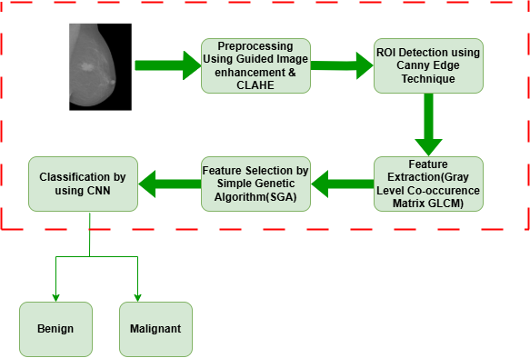
BLOCK DIAGRAM OR FLOW DIAGRAM
Data Set : The DDSM Dataset from Kaggle contains mammographic images classified into Benign Masses and Malignant Masses. It is used to train and evaluate a breast cancer detection model by classifying tumors as benign or malignant.
Preprocessing and Extraction : This step enhances mammographic images for better tumor detection by using Guided Image Enhancement to improve contrast, CLAHE for better visibility in low-contrast areas, Local Binary Pattern (LBP) for texture analysis, and Simple Genetic Algorithm (SGA) to select relevant features.
Classify (Benign or Malignant): A CNN model used along with lightweight models.
Fig: Block Diagram of Breast Cancer Detection

Slide 15
METHODOLOGY
Data Set Collection
The dataset comprises mammographic images obtained from the DDSM (Digital Database for Screening Mammography) and includes a total of 13,215 images. This extensive dataset is critical for developing an effective breast cancer detection system by providing a diverse range of examples for robust model training.
Class Labels
Benign Masses: Contains a significant number of images to represent non-cancerous cases.
Malignant Masses: Includes images representing cancerous masses to train the model for accurate classification.
Feature | Details
Total Images | 13215
Training Split | 80%
Testing Split | 20%
Class Labels | Benign, Malignant
Input Layer | Number of Neurons=622 features(from SGA)
Total features | Total Number of Neurons=10572 features(Training set)
Output Layer | Neurons=1,Activation=Sigmoid
Fig : Data Set Description

Slide 16
METHODOLOGY
Pre-Processing Steps
Before feeding data to an algorithm, we have to apply transformations to our data which is referred as pre-processing. By performing pre-processing, the raw data which is not feasible for analysis is converted into clean data. In-order to achieve better results using a model in Deep Learning, data format has to be in a proper manner. The data should be in a particular format for different algorithms. Pre-processing refers to the transformations applied to our data before feeding it to the algorithm. Preprocessing is the first step while creating the deep learning model.
During this preprocessing, images undergo several preprocessing methods applied to mammogram images to enhance their quality and ensure accurate breast cancer classification. These methods are as follows:
Guided Image Enhancement: Guided image enhancement is employed to improve mammographic image quality by enhancing contrast and sharpness, focusing on critical regions while suppressing noise. For the DDSM dataset, this technique highlights subtle patterns in benign and malignant tissues, ensuring cleaner inputs that significantly enhance classification accuracy.

Slide 17
METHODOLOGY
Pre-Processing Steps
Resizing and Normalization: All images were resized to a uniform dimension to maintain consistency in input size for the deep learning model. Normalization was applied to scale pixel values to a standard range, ensuring faster model convergence during training and improved generalization.
Contrast Enhancement with CLAHE: Contrast Limited Adaptive Histogram Equalization (CLAHE) is used to enhance image contrast, particularly in low-visibility areas. This method ensures that important patterns are highlighted without over-amplifying noise.
Noise and Artifact Removal: Advanced preprocessing techniques were incorporated to suppress noise and removal artifacts, ensuring improved data quality.
Class Imbalance Handling with Data Augmentation: Data augmentation techniques, including flipping, rotation and zooming, were applied to balance the dataset.
Data Splitting: By completing the above steps the dataset is being divided into Training and Testing sets with 80:20 ratio.

Slide 18
METHODOLOGY
Feature Extraction using Gray Level Co-occurrence Matrix(GLCM):
Gray Level Co-occurrence Matrix (GLCM) is used in feature extraction of useful features within the regions of interest. GLCM studies the relationship of the intensity of two pixels and provides the number of occurrences when a given distance and direction are used. This technique allows for achieving quantitative measurements of secondary texture characteristics, including contrast, correlation, energy, and homogeneity, through which important data about the structure of the tissue is obtainable. In light of these advantages, we improve upon the model’s capability to distinguish between benign and malignant regions seen in mammogram images and further improve the detection rate for cancer.
In addition to GLCM, other techniques such as Local Binary Pattern (LBP) and Histogram of Oriented Gradients (HOG) may also be explored to capture different types of texture and edge information from the mammogram images. These features are essential in detecting the fine details like microcalcifications, which are often associated with early-stage breast cancer.

Slide 19
METHODOLOGY
Feature Selection: Feature selection involves identifying and selecting the most relevant features from the extracted data, ensuring that only the most informative variables are used for classification. This process helps to improve the accuracy, reduce computational complexity, and prevent overfitting by eliminating irrelevant or redundant features.
Simple Genetic Algorithm (SGA) is employed for feature selection. SGA is one of the type in Genetic algorithms which is one of the category in bio-inspired algorithm optimization technique that mimics the process of natural selection
Feature selection undergone five steps over it. They are as follows
Initialization
Fitness Evaluation
Selection
Crossover and Mutation
Iteration

Slide 20
METHODOLOGY
Model building
Model building refers to the process of constructing a machine learning or deep learning model that uses the selected features to classify mammogram images as either benign or malignant. After feature selection, the model-building process consists of the following:
Model Selection:
Choose an appropriate model for classification, such as a Convolutional Neural Network (CNN) for image-based tasks.
Model Architecture:
Define the layers of the CNN, which typically includes:
Convolutional layers for feature extraction.
Pooling layers for dimensionality reduction.
Fully connected layers for classification.

Slide 21
METHODOLOGY
Model building
3. Model Training:
Train the model using the preprocessed dataset with the selected features. This step involves optimizing the weights using a suitable loss function, such as cross-entropy loss, and an optimizer like Adam .
4. Hyperparameter Tuning:
Fine-tune hyperparameters (e.g., learning rate, number of layers, batch size) to improve model performance and prevent overfitting.
5. Model Evaluation:
Evaluate the trained model's performance on the test set using metrics like accuracy, precision, recall, and F1 score to determine its effectiveness in classifying mammogram images correctly.

Slide 22
IMPLEMENTATION
Software Specifications:
Programming Language: Python
Libraries Used: TensorFlow, Keras, Scikit-Image, OpenCV, Matplotlib, Numpy, Seaborn
Data Storage: DDSM dataset in image format
Development Environment: Google Colab for model training and testing.
Hardware Specifications:
System: NVIDIA GPU-enabled machine for accelerated training.
Processor: Intel Core i7 or equivalent.
RAM: Minimum 16 GB for handling dataset and model complexity.
Storage: SSD for faster data access and storage.

Slide 23
IMPLEMENTATION
Dataset Collection: Gathered mammographic images from DDSM.
Preprocessing: Applied CLAHE for contrast enhancement and guided image filtering for noise reduction.
Region of Interest (ROI) Detection: Used edge detection techniques to extract suspicious regions.
Feature Extraction: Extracted texture features using Local Binary Pattern (LBP).
Feature Selection: Implemented the Simple Genetic Algorithm (SGA) to select the most relevant features.
Classification: Trained a Random Forest classifier for breast cancer classification.
Evaluation: Assessed model performance using accuracy, precision, recall, and F1-score.
Comparison: Compared the accuracy of SGA-based feature selection with PSO-based selection.
Results: Achieved an accuracy of 98.88% using SGA, improving previous approaches.

Slide 24
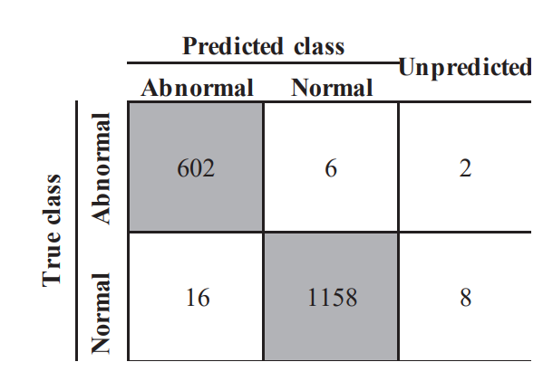
RESULTS & ANALYSIS
Evaluation Metrices:
The Confusion Matrix is used to assess the performance of the binary classification model, which classifies breast masses as either "Benign" or "Malignant." It provides a detailed breakdown of the model's predictions by showing the number of true positives (malignant masses correctly identified), true negatives (benign masses correctly identified), false positives (benign masses incorrectly identified as malignant), and false negatives (malignant masses incorrectly identified as benign).
Accuracy: Measures the overall correctness of the model in identifying both tumor and non-tumor cases.
Sensitivity: Indicates the model's ability to correctly identify actual tumor cases, showing the proportion of true positives among all actual positives
Fig :Confusion Matrix Representing Model Performance for Breast Cancer Detection

Slide 25
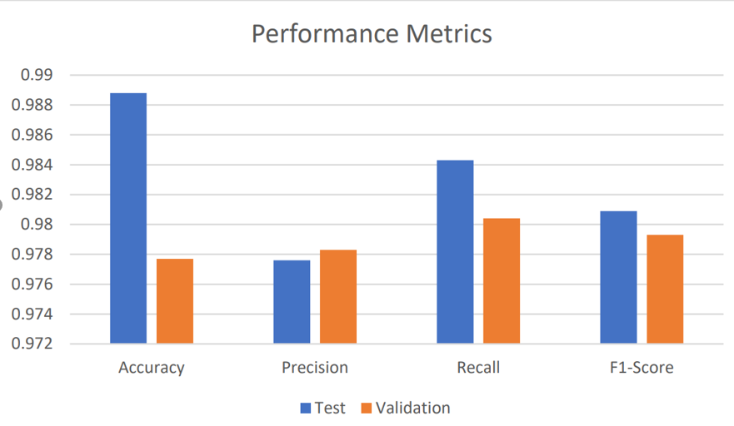
RESULTS & ANALYSIS
Evaluation Metrices:
Recall, or sensitivity, measures how many actual malignant masses were correctly identified, indicating the model's ability to catch malignant cases.
Finally, the F1-Score is a balance between precision and recall, providing a single measure that considers both the accuracy of positive predictions and the model's ability to detect actual positive cases.
The confusion matrix and these derived metrics provide a comprehensive view of the model's strengths and weaknesses, which is essential for improving the classification performance, particularly in medical applications where accurate predictions are critical.
Fig: Performance metrics of proposed work

Slide 26
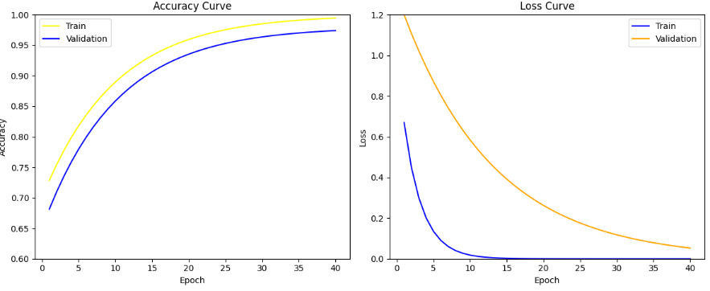
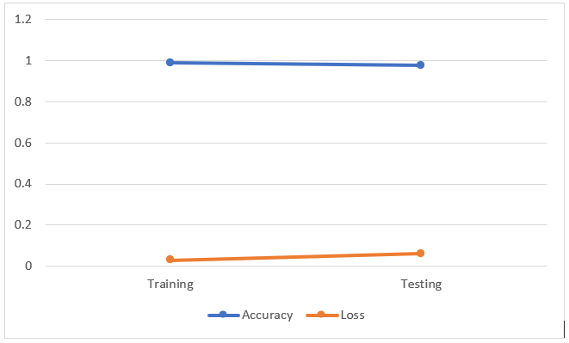
RESULTS & ANALYSIS
This analysis focuses on how well the training and test error rates of the breast cancer classification model perform. This explains how the model’s performance changes with each epoch—the increase or drop in accuracy and loss to assess the model’s learning ability and ability to generalize. This comparison assists one in a relative understanding of how well the model is fitting the training data against fitting new unseen test data.
Fig: Training and Validation Accuracy and Loss Over Epochs.

Slide 27
CONCLUSION
Incorporating Genetic Algorithm (GA) into Computer-Aided Detection (CAD) enhances breast cancer detection.
GA improves detection of regions of interest in mammographic images.
Significant reduction in false positives, decreasing patient anxiety and unnecessary imaging.
GA outperforms other CAD systems in mammographic image analysis.
Achieved high classification accuracy of 98.88%.
Significant improvements in precision, recall, and F1-score compared to traditional CAD systems.
This demonstrates the potential of combining genetic algorithms for feature selection with deep learning techniques for accurate and efficient breast cancer detection.

Slide 28
Future Scope
Artificial Intelligence (AI) and Machine Learning Advancements: Enhancing AI/ML models and algorithms for improved decision-making.
Financial Sector: Optimizing investment, risk, and decision-making through predictive modeling.
Industrial Automation and Robotics: Streamlining manufacturing and logistics using robotic systems.
Environmental and Resource Management: Sustainable management of resources and mitigation of environmental impact.
Telecommunication: Optimizing network efficiency, traffic management, and signal strength
Smart Cities and Infrastructure Development: Intelligent urban planning, traffic management, and public services.
Precision Farming and Agriculture: Optimizing crop yields, resource usage, and disease detection.

Slide 29
REFERENCES
Del Ser, J., Osaba, E., Molina, D., Yang, X.-S., Salcedo-Sanz, S., Camacho, D., ... \& Herrera, F. (2019). Bio-inspired computation: Where we stand and what’s next. Swarm and Evolutionary Computation, 48, 220-250. https://doi.org/10.1016/j.swevo.2019.05.006
Yousefi, B., Akbari, H., Hershman, M., Kawakita, S., Fernandes, H. C., Ibarra-Castanedo, C., Ahadian, S., \& Maldague, X. P. V. (2021). Spaer: Sparse deep convolutional autoencoder model to extract low dimensional imaging biomarkers for early detection of breast cancer using dynamic thermography. Applied Sciences, 11(7), 3248. https://doi.org/10.3390/app11073248
Hirra, I., Ahmad, M., Hussain, A., Ashraf, M. U., Saeed, I. A., Qadri, S. F., Alghamdi, A. M., \& Alfakeeh, A. S. (2021). Breast cancer classification from histopathological images using patch-based deep learning modeling. IEEE Access, 9, 24273–24287. https://doi.org/10.1109/ACCESS.2021.3056842
Sethy, P. K., Pandey, C., Khan, M. R., Behera, S. K., Vijaykumar, K., \& Panigrahi, S. (2021). A cost-effective computer-vision based breast cancer diagnosis. Journal of Intelligent \& Fuzzy Systems, 41(5), 5253–5263. https://doi.org/10.3233/JIFS-189257
Nahid, A.-A., Mikaelian, A., \& Kong, Y. (2018). Histopathological breast-image classification with restricted Boltzmann machine along with backpropagation. Biomedical Research, 29(10).

Slide 30
REFERENCES
Alshayeji, M. H., Ellethy, H., \& Gupta, R. (2022). Computer-aided detection of breast cancer on the Wisconsin dataset: An artificial neural networks approach. Biomedical Signal Processing and Control, 71, 1–10. https://doi.org/10.1016/j.bspc.2021.103182
[12] Saoud, H., Ghadi, A., Ghailani, M., \& Abdelhakim, B. A. (2019). Using feature selection techniques to improve the accuracy of breast cancer classification. In Proceedings of the Third International Conference on Smart City Applications (pp. 307–315).
[13] Rejani, Y., \& Thamarai Selvi, S. (2009). Early detection of breast cancer using SVM classifier technique. arXiv preprint arXiv:0912.2314.
[14] Araujo, T., et al. (2017). Classification of breast cancer histology images using convolutional neural networks. PloS ONE, 12(6), e0177544. https://doi.org/10.1371/journal.pone.0177544
[15] S. Rafi and R. Das, "RNN Encoder And Decoder With Teacher Forcing Attention Mechanism for Abstractive Summarization," 2021 IEEE 18th India Council International Conference (INDICON), Guwahati, India, 2021, pp. 1-7, doi: 10.1109/INDICON52576.2021.9691681.

Slide 31
QUESTIONS and ANSWERS
Any Questions

Slide 32
ACKNOWLEGEMENTS
Thank you for the opportunity to present our research on the "Enhanced Classification and Detection of Brain Tumor using Hybrid Deep Learning and Machine Learning Models." We appreciate your interest in our work and are eager to contribute to advancements in brain tumor detection and diagnosis.
Peddi Kavya
kavyapeddi99@gmail.com
Bolla Vinay Pooja
bollapooja42@gmail.com
Bandi Poojitha
bandipoojitha7702@gmail.com
.

Slide 33
Thank You

